Slide 1
Stochastic Gradient Descent for Large Scale Machine Learning Problems
Ravi Raghavan and Lakshitha Ramanayake

Slide 2
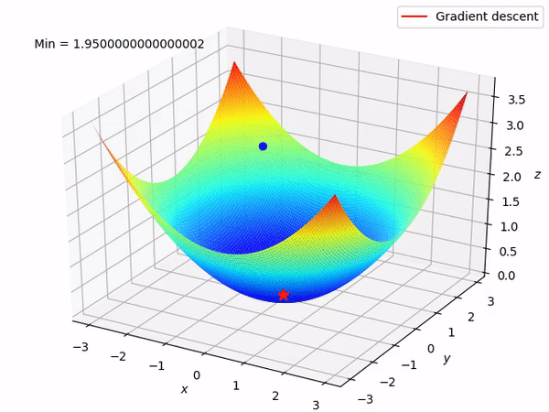
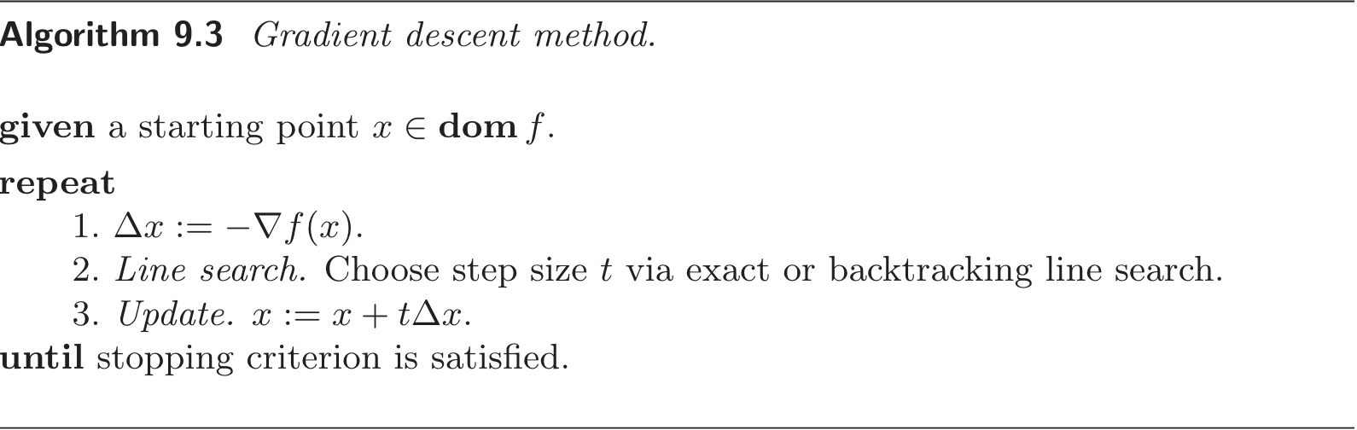
Review: Gradient Descent
Gradient Descent is a first-order, iterative algorithm used to minimize differentiable functions
Animation Link: https://suniljangirblog.wordpress.com/2018/12/03/the-outline-of-gradient-descent/
Notes:
Talk about this Algorithm very succinctly. Don’t waste too much time on this slide

Slide 3
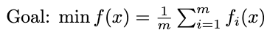
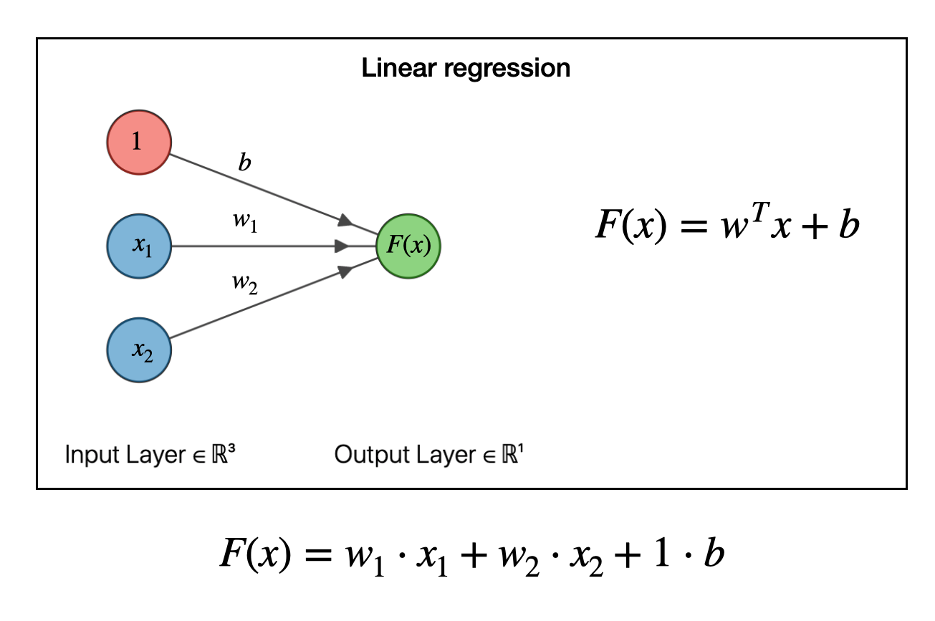
Optimization: Large Scale Machine Learning Problems
Image Link: https://joshuagoings.com/2020/05/05/neural-network/
Notes:
Articulate how the Loss Function across a Training Data Set is essentially the average of the cumulative Loss across all the individual data points

Slide 4
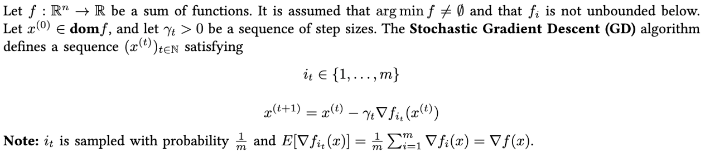
Stochastic Gradient Descent Algorithm
Notes:
Be succinct here. The main point is to state that we sample gradients and that the Expected Value is equal to the gradient value
State that, in Mini Batch Stochastic Gradient Descent, we sample b gradients

Slide 5
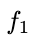
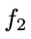
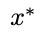
Interpolation
Notes:
First state that x^* minimizes f as well
State that, when Interpolation holds true, no matter what function gradient we sample, we know that we are heading in the right direction.

Slide 6
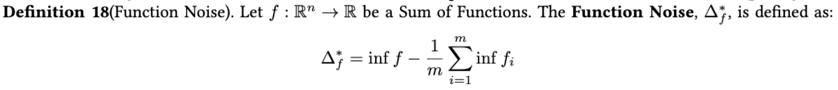
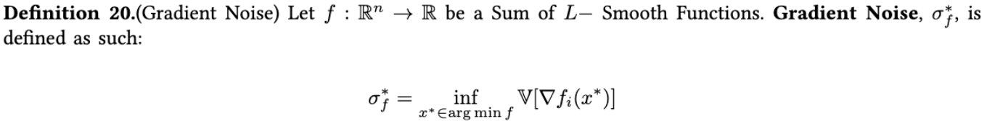
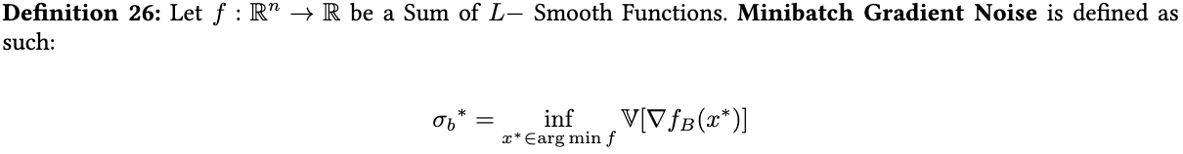
Proximity to Interpolation
Notes:
Some stochastic problems are easier than others. For instance, a problem where all the fi ’s are the same is easy to solve, as it suffices to minimize one fi to obtain a minimizer of f. We can also imagine that if the fi are not exactly the same but look similar, the problem will also be easy. And of course, we expect that the easier the problem, the faster our algorithms will be. In this section we present one way to quantify this phenomena.

Slide 7
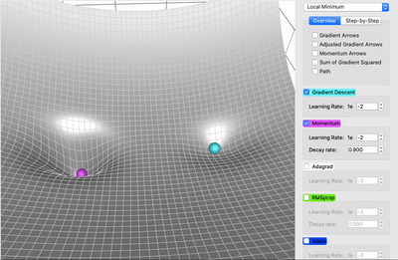
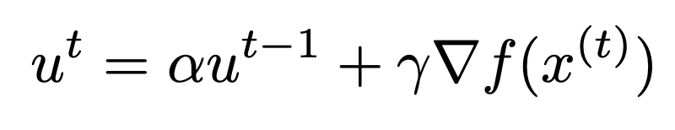
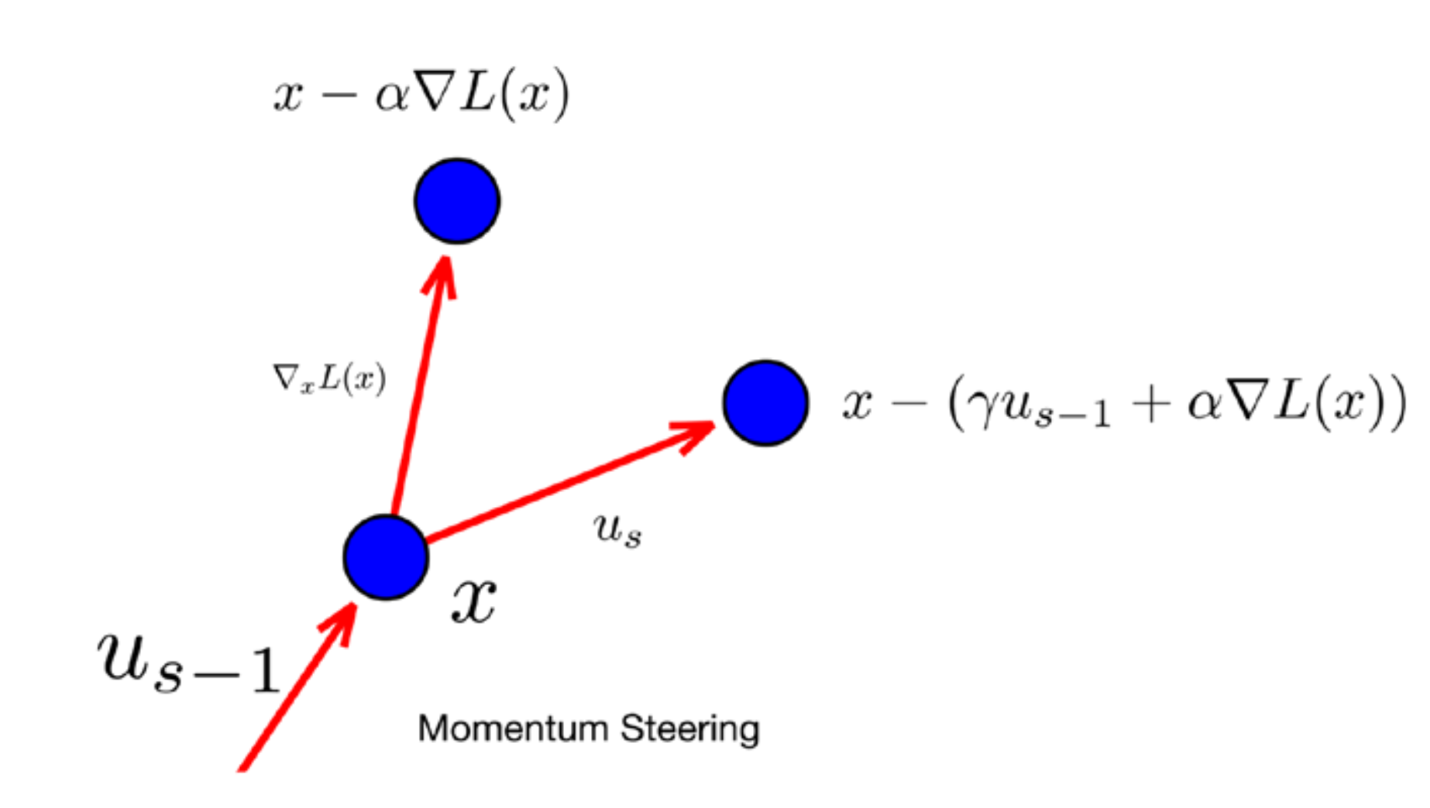

Variants of SGD
Momentum
“Incorporates a fraction of the previous update vector into the current update.”
Velocity Term
: momentum coefficient
: learning rate
Update Step
With momentum
Without momentum
Notes:
Update Step: Momentum as a memory of previous gradients
Diagram: Direction moves towards the direction of previous iterate
Advantages:
Faster convergence when the algorithm moves in the same direction
Jumps over local minimums

Slide 8
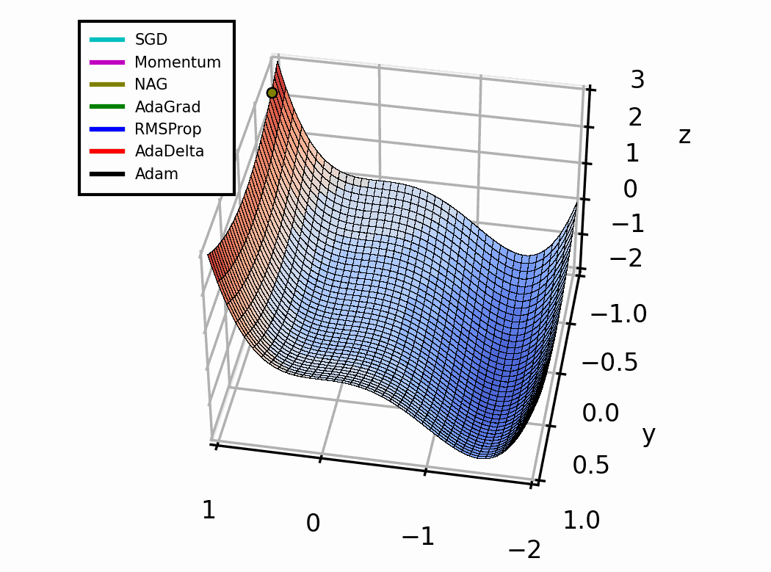
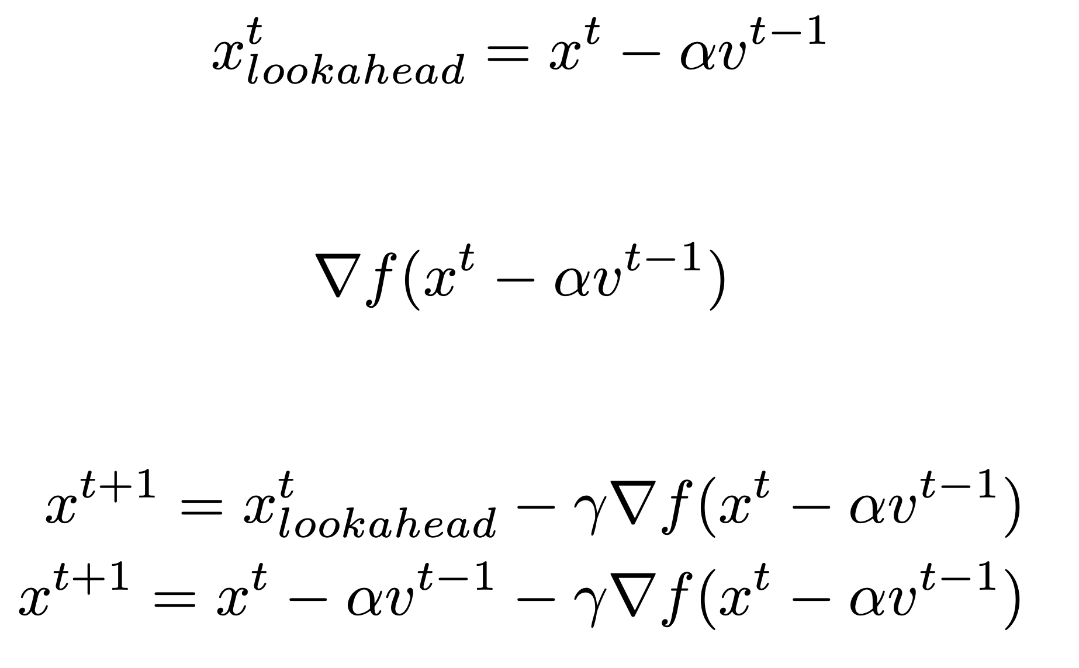
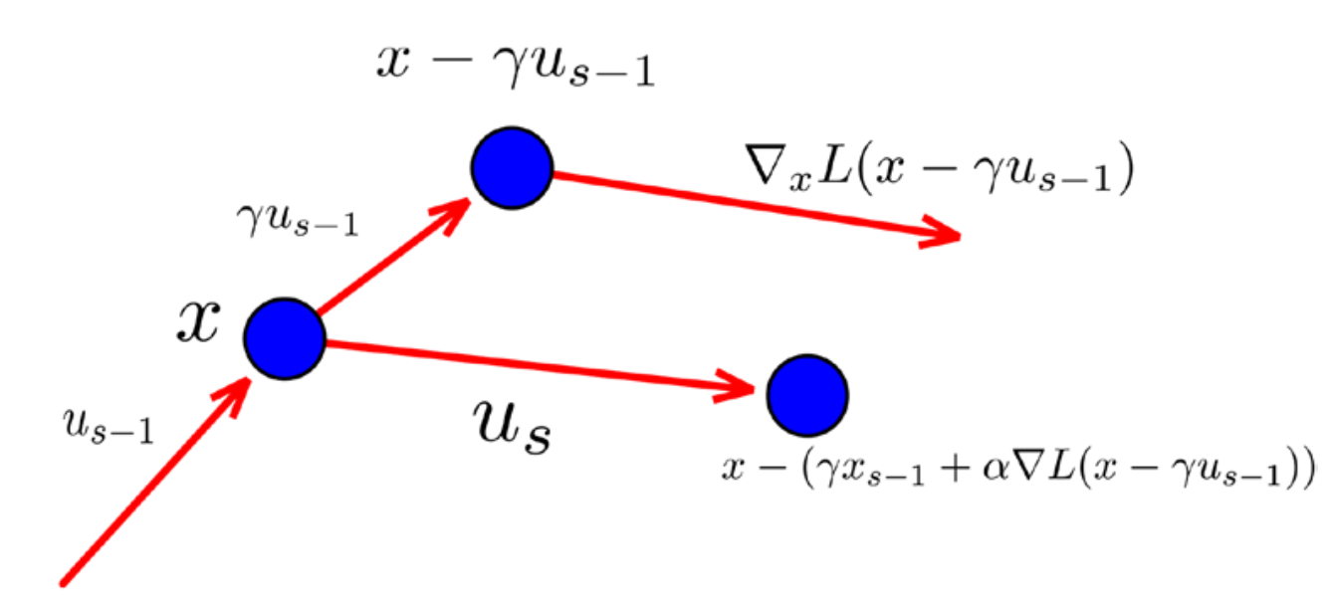
Variants of SGD
Nestrov Accelerated Gradient
A momentum-based variant of SGD.
Now the gradient is calculated at a point ahead.
Major steps,
Looking Ahead
Computing Gradient
Gradient Step
Image: https://towardsdatascience.com/a-visual-explanation-of-gradient-descent-methods-momentum-adagrad-rmsprop-adam-f898b102325c
Notes:
Disadvantage of Momentum
Main difference is in the gradient calculation step.
Looks ahead and learns the curvature.

Slide 9
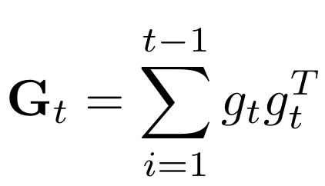
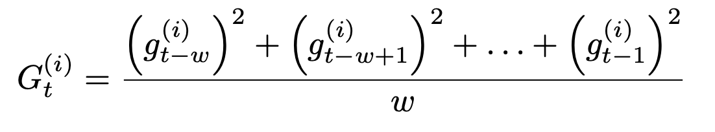
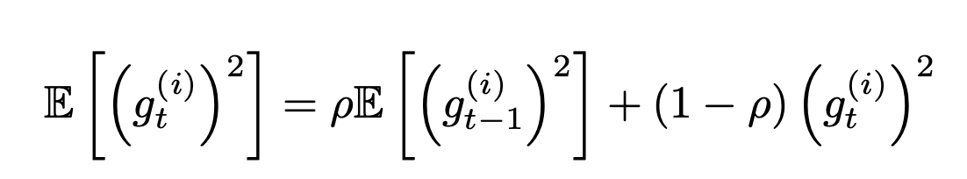
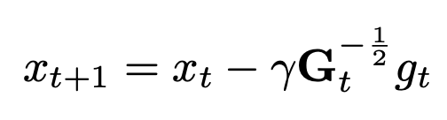
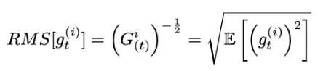
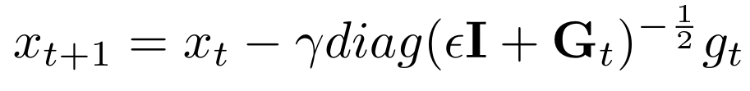
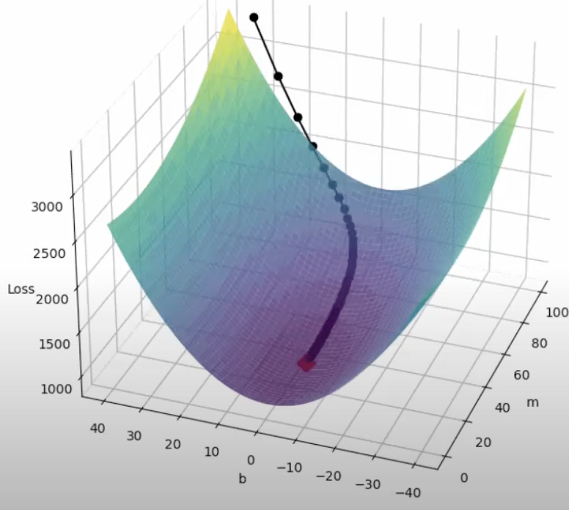
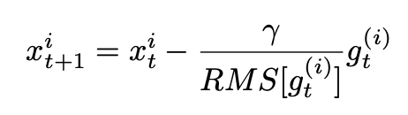
Variants of SGD: Adaptive
AdaGrad
RMS Prop
Let’s define $f(x)$ to be the stochastic objective function with parameter $x$, the function evaluation at step $t$ as $f_{t}(x)$, the gradient of the function with respect to $x$ at step $t$ to be $g_{t}$,
Define,
Define, (p- decaying factor)
Then, the update step,
General:
Simplifiedl:
Then, the update step,
https://towardsdatascience.com/a-visual-explanation-of-gradient-descent-methods-momentum-adagrad-rmsprop-adam-f898b102325c
Notes:
An adaptive learning method. → Each parameter has its own it’s learning rate.
Adapts learning rate for each parameter based on previous gradients of the parameter.
Addresses the elongated ball problem encountered in a sparse data setting. → Image
Adagrad step,
Adagard → All the previous gradient information,
RMSProp → A window of sum of squres
Comutationally equivalent and efficient way of discussing this.

Slide 10
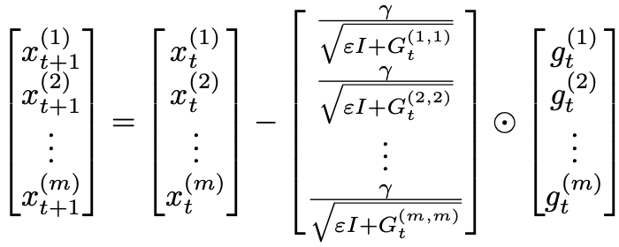
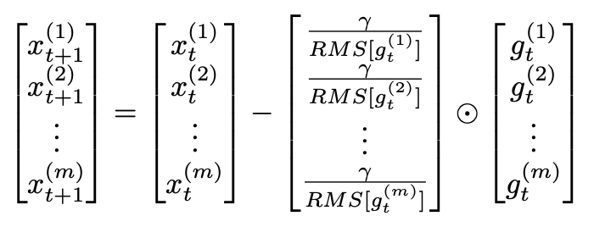
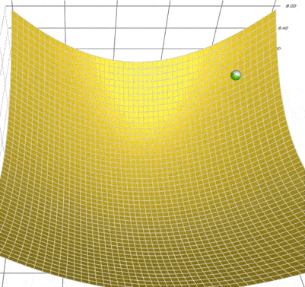
Variants of SGD
AdaGrad
RMS Prop
https://towardsdatascience.com/a-visual-explanation-of-gradient-descent-methods-momentum-adagrad-rmsprop-adam-f898b102325c

Slide 11
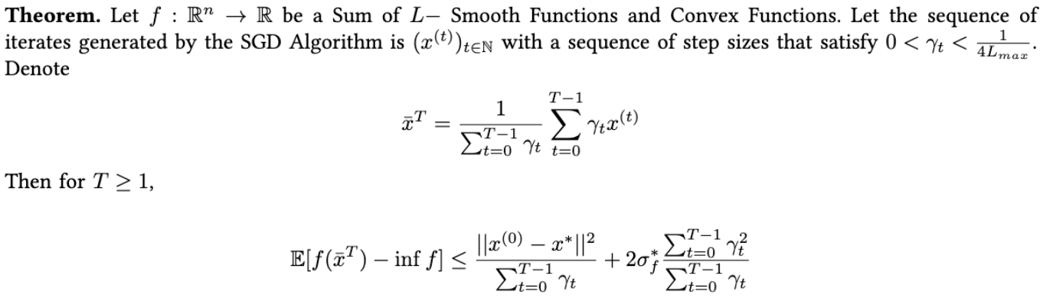
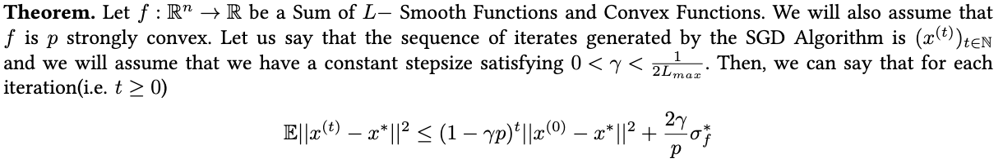
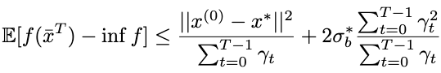
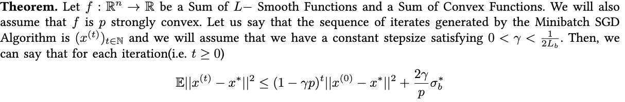
Convergence Analysis
SGD |  | Mini Batch SGD
Convex | p- Strong Convex | Convex | p - Strong Convex
Objective Function is Sum of L-Smooth and Convex Functions Assumes a variable step size | Objective Function is Sum of L-Smooth and Convex Functions Objective Function is p-strongly convex Assumes a constant step size | Objective Function is Sum of L-Smooth and Convex Functions Assumes a variable step size | Objective Function is Sum of L-Smooth and Convex Functions Objective Function is p-strongly convex Assumes a constant step size
Notes:
Mention how Interpolation Proximity metric is used in all of these convergences
Mention how when Interpolation is 0, SGD reduces to GD

Slide 12
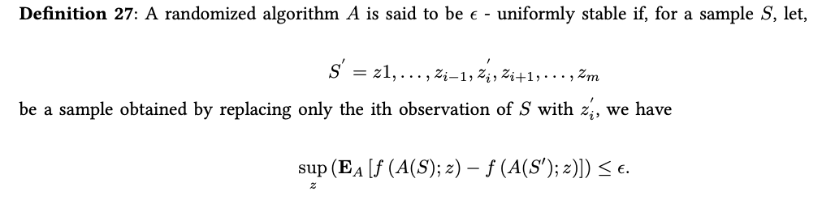
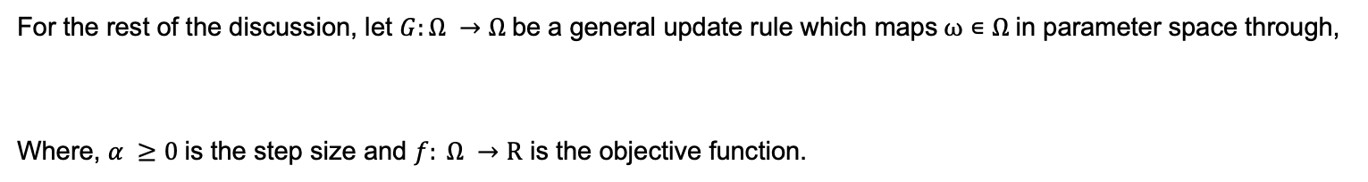
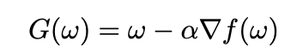
Stability
Stability
How different sequences of an update rule on S and S’ diverge given they were initialized from the same point.
Notes:
The supremum of the expected difference between the loss functions when you change the dataset by one sample

Slide 13
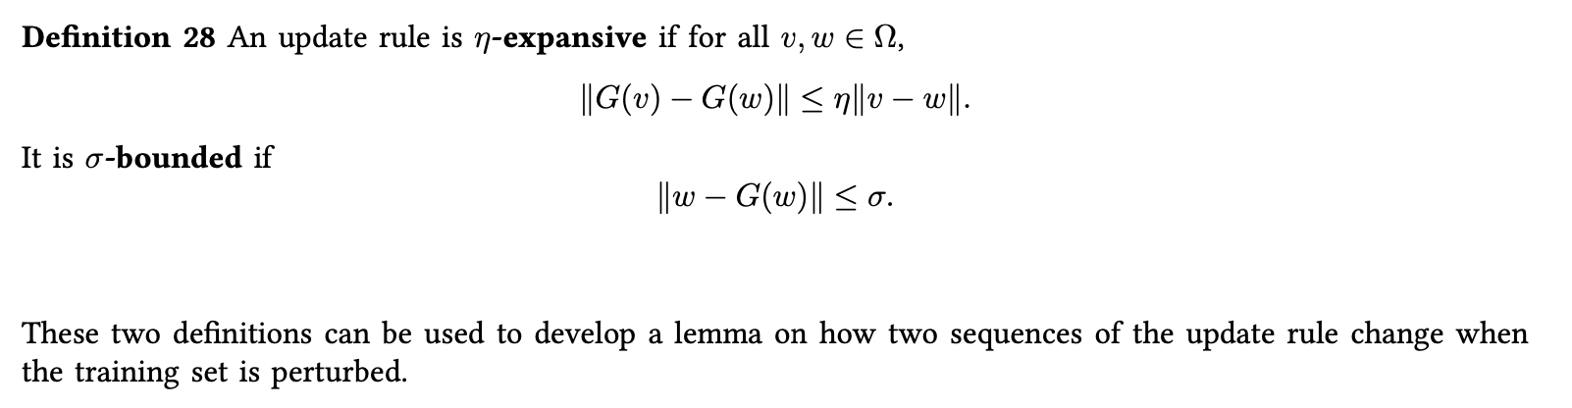
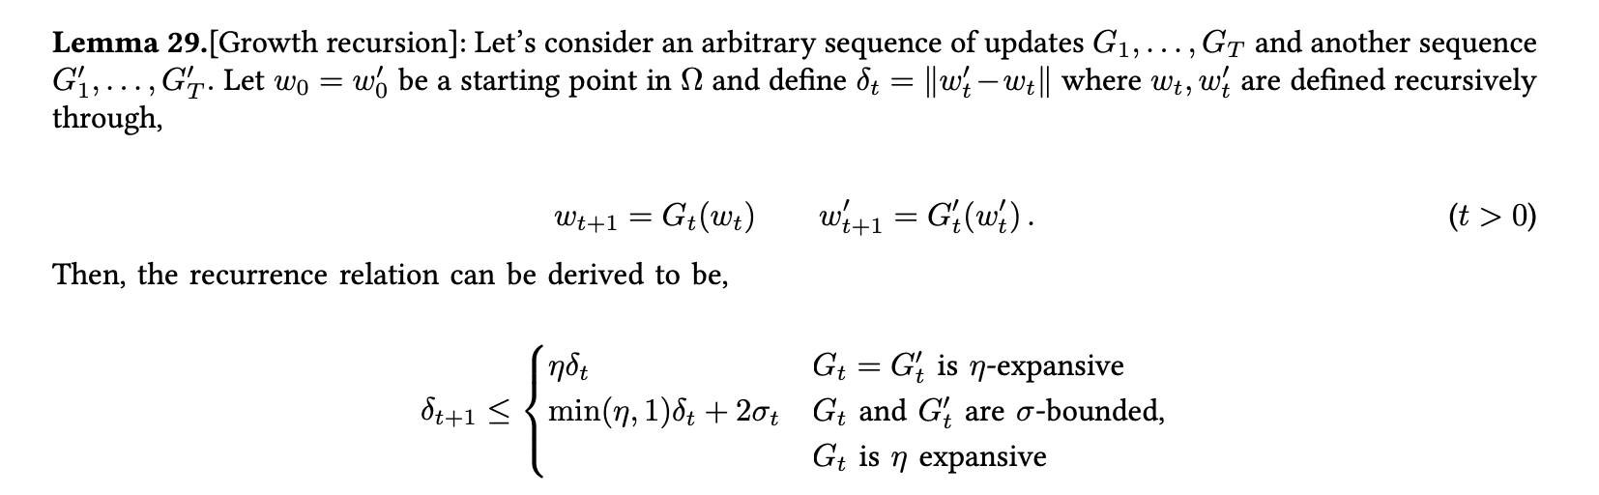
Stability

Slide 14
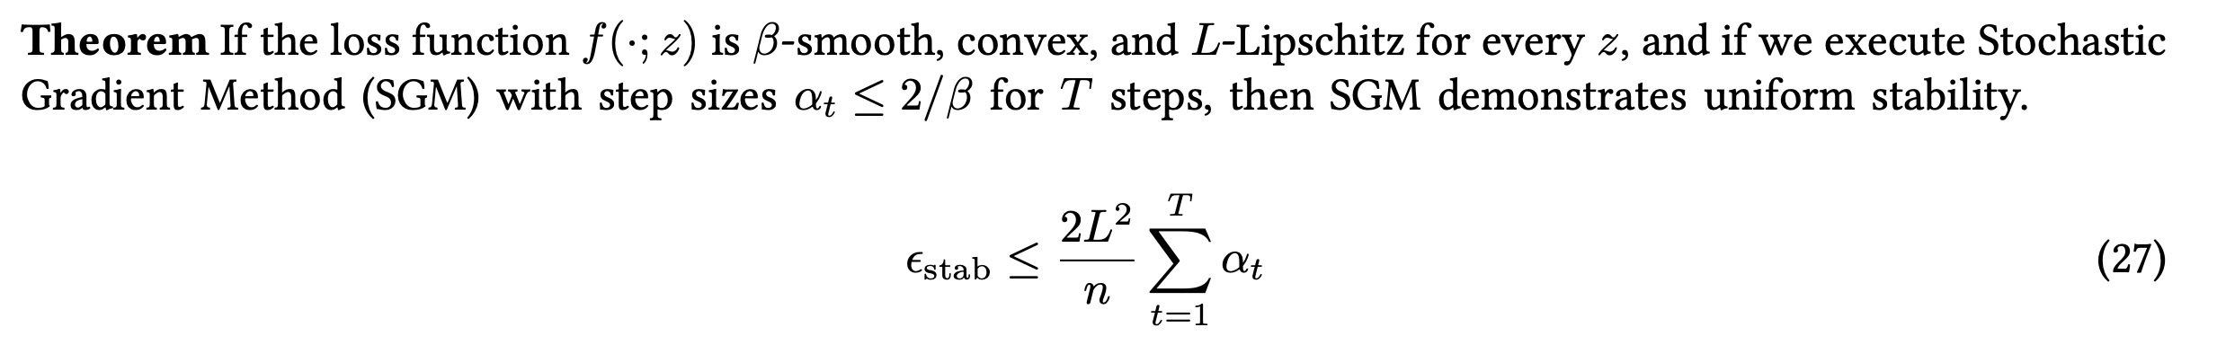
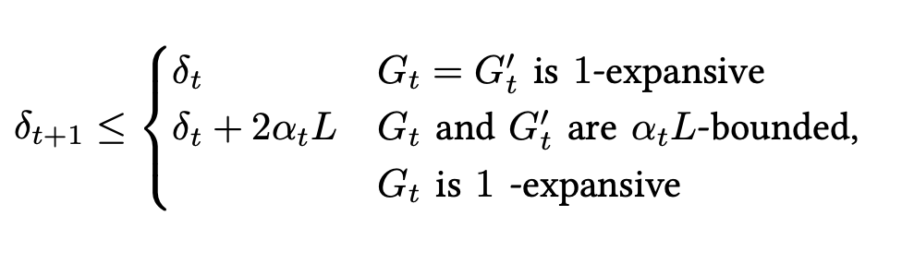
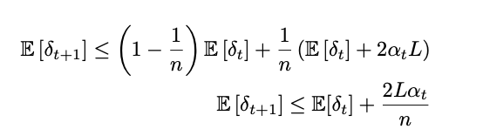
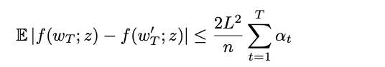
Stability
Stability of SGD in Convex Optimization: [2] Hardt et al., 2016
Proof Sketch

Slide 15
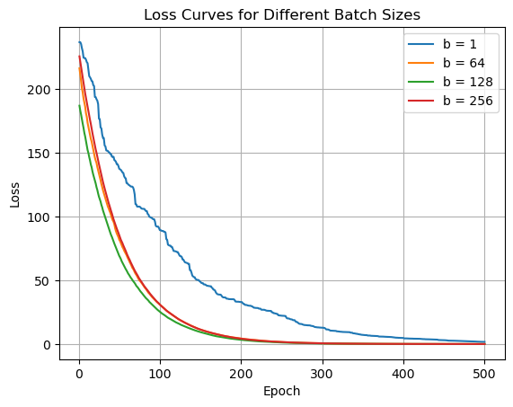
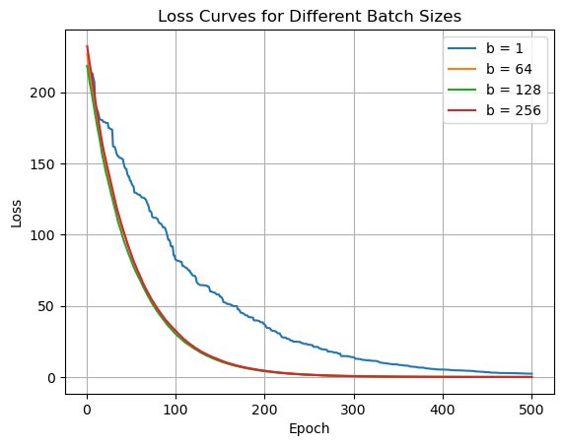
Numerical Simulations
How does performance vary with Mini Batching ,
No Noise
With Noise

Slide 16
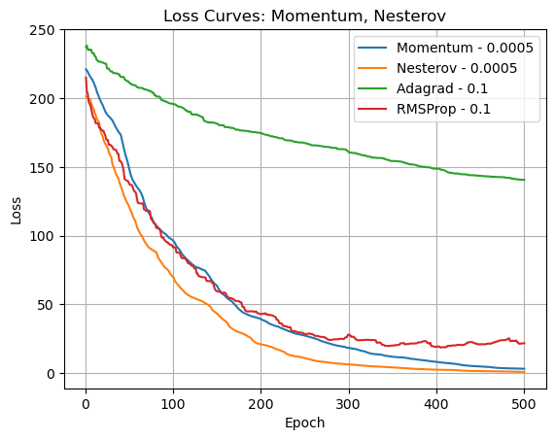
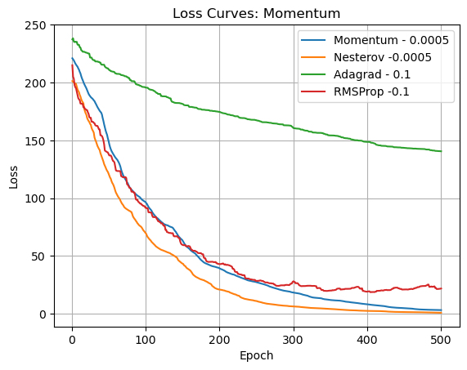
Numerical Simulations
How does different Variants Perform,
No Noise
With Noise

Slide 17
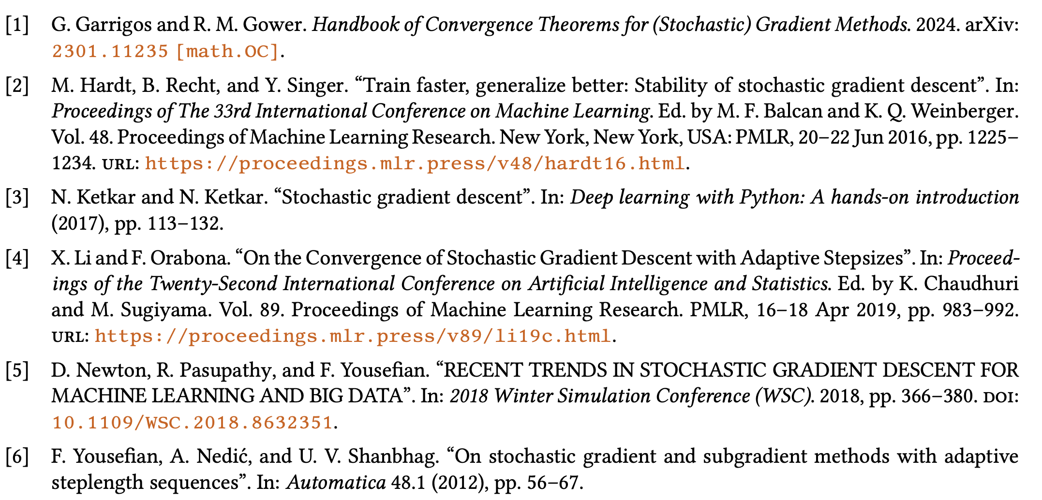
References

Slide 18
Thank You!

